Slide 1
MongoDB Spectra Hackathon
Fantastic Security Questions and Where to Find Them

Slide 2

The Team
Karen Huaulmé
Austin - Developer Advocate
@YouOldMaid
Ken W. Alger
Oregon - Developer Advocate
@KenWalger
Building Together
Wesley Faulkner
Austin - Developer Advocate
@Wesley83

Slide 3
AGENDA Why MongoDB? What is Atlas? What is Stitch? Build Your 1st MongoDB Application
MongoDB Jumpstart!

Slide 4
What is MongoDB
?
And Why Use MongoDB

Slide 5
MongoDB Stores Data in Documents
{
first_name: "Paul",
surname: "Miller",
cell: "447557505611",
city: "London",
location: [45.123,47.232],
profession: ["banking", "finance", "trader"],
cars: [
{
model: "Bentley",
year: 1973
},
{
model: "Rolls Royce",
year: 1965
}
]
}
Notes:
JavaScript Object Notation
MongoDB’s document model is not just a key-value store.

Slide 6
MongoDB Stores Data in Documents
{
first_name: "Paul",
surname: "Miller",
cell: "447557505611",
city: "London",
location: [45.123,47.232],
profession: ["banking", "finance", "trader"],
cars: [
{
model: "Bentley",
year: 1973
},
{
model: "Rolls Royce",
year: 1965
}
]
}
Notes:
Fields

Slide 7
MongoDB Stores Data in Documents
{
first_name: "Paul",
surname: "Miller",
cell: "447557505611",
city: "London",
location: [45.123,47.232],
profession: ["banking", "finance", "trader"],
cars: [
{
model: "Bentley",
year: 1973
},
{
model: "Rolls Royce",
year: 1965
}
]
}
Notes:
Field Values

Slide 8
MongoDB Stores Data in Documents
{
first_name: "Paul",
surname: "Miller",
cell: "447557505611",
city: "London",
location: [45.123,47.232],
profession: ["banking", "finance", "trader"],
cars: [
{
model: "Bentley",
year: 1973
},
{
model: "Rolls Royce",
year: 1965
}
]
}
Notes:
Field Values can be strings

Slide 9
MongoDB Stores Data in Documents
{
first_name: "Paul",
surname: "Miller",
cell: "447557505611",
city: "London",
location: [45.123,47.232],
profession: ["banking", "finance", "trader"],
cars: [
{
model: "Bentley",
year: 1973
},
{
model: "Rolls Royce",
year: 1965
}
]
}
Notes:
Field Values can be :
32-bit integer
Double, longs, and decimals

Slide 10
MongoDB Stores Data in Documents
{
first_name: "Paul",
surname: "Miller",
cell: "447557505611",
city: "London",
location: [45.123,47.232],
profession: ["banking", "finance", "trader"],
cars: [
{
model: "Bentley",
year: 1973
},
{
model: "Rolls Royce",
year: 1965
}
]
}
Notes:
Field Values can be : geolocation

Slide 11
MongoDB Stores Data in Documents
{
first_name: "Paul",
surname: "Miller",
cell: "447557505611",
city: "London",
location: [45.123,47.232],
profession: ["banking", "finance", "trader"],
cars: [
{
model: "Bentley",
year: 1973
},
{
model: "Rolls Royce",
year: 1965
}
]
}
Notes:
Fields can contain arrays. Here we see an array of Strings

Slide 12
MongoDB Stores Data in Documents
{
first_name: "Paul",
surname: "Miller",
cell: "447557505611",
city: "London",
location: [45.123,47.232],
profession: ["banking", "finance", "trader"],
cars: [
{
model: "Bentley",
year: 1973
},
{
model: "Rolls Royce",
year: 1965
}
]
}
Notes:
Fields can contain an array of subdocuments
The value of a field can be a variety of types including objects, booleans, dates, and timestamps among others.

Slide 13
MongoDB Stores Data in Documents
{
first_name: "Paul",
surname: "Miller",
cell: "447557505611",
city: "London",
location: [45.123,47.232],
profession: ["banking", "finance", "trader"],
cars: [
{
model: "Bentley",
year: 1973
},
{
model: "Rolls Royce",
year: 1965
}
]
}
Notes:
When people talk about MongoDB, they’ll often use the term nonrelational. But that doesn’t mean we don’t store relationships. We just do it in a different way. Let’s walk through an example of how you would model this same data we have in the document on the left in SQL tables

Slide 14
Modeling Data: MongoDB vs SQL
{
first_name: "Paul",
surname: "Miller",
cell: "447557505611",
city: "London",
location: [45.123,47.232],
profession: ["banking", "finance", "trader"],
cars: [
{
model: "Bentley",
year: 1973
},
{
model: "Rolls Royce",
year: 1965
}
]
}
Users
ID | first_name | surname | cell | city | location_x | location_y
1 | Paul | Miller | 447557505611 | London | 45.123 | 47.232
Notes:
When people talk about MongoDB, they’ll often use the term nonrelational. But that doesn’t mean we don’t store relationships. We just do it in a different way. Let’s walk through an example of how you would model this same data we have in the document on the left in SQL tables

Slide 15
Modeling Data: MongoDB vs SQL
{
first_name: "Paul",
surname: "Miller",
cell: "447557505611",
city: "London",
location: [45.123,47.232],
profession: ["banking", "finance", "trader"],
cars: [
{
model: "Bentley",
year: 1973
},
{
model: "Rolls Royce",
year: 1965
}
]
}
Users
ID | first_name | surname | cell | city | location_x | location_y
1 | Paul | Miller | 447557505611 | London | 45.123 | 47.232
Professions
ID | user_id | profession
10 | 1 | banking
11 | 1 | finance
12 | 1 | trader
Notes:
When people talk about MongoDB, they’ll often use the term nonrelational. But that doesn’t mean we don’t store relationships. We just do it in a different way. Let’s walk through an example of how you would model this same data we have in the document on the left in SQL tables

Slide 16
Modeling Data: MongoDB vs SQL
{
first_name: "Paul",
surname: "Miller",
cell: "447557505611",
city: "London",
location: [45.123,47.232],
profession: ["banking", "finance", "trader"],
cars: [
{
model: "Bentley",
year: 1973
},
{
model: "Rolls Royce",
year: 1965
}
]
}
Users
ID | first_name | surname | cell | city | location_x | location_y
1 | Paul | Miller | 447557505611 | London | 45.123 | 47.232
Professions
Cars
ID | user_id | profession
10 | 1 | banking
11 | 1 | finance
12 | 1 | trader
ID | user_id | model | year
20 | 1 | Bentley | 1973
21 | 1 | Rolls Royce | 1965
Notes:
When people talk about MongoDB, they’ll often use the term nonrelational. But that doesn’t mean we don’t store relationships. We just do it in a different way. Let’s walk through an example of how you would model this same data we have in the document on the left in SQL tables

Slide 17
Modeling Data: MongoDB vs SQL
{
first_name: "Paul",
surname: "Miller",
cell: "447557505611",
city: "London",
location: [45.123,47.232],
profession: ["banking", "finance", "trader"],
cars: [
{
model: "Bentley",
year: 1973
},
{
model: "Rolls Royce",
year: 1965
}
]
}
Users
ID | first_name | surname | cell | city | location_x | location_y
1 | Paul | Miller | 447557505611 | London | 45.123 | 47.232
Professions
Cars
ID | user_id | profession
10 | 1 | banking
11 | 1 | finance
12 | 1 | trader
ID | user_id | model | year
20 | 1 | Bentley | 1973
21 | 1 | Rolls Royce | 1965
Notes:
When people talk about MongoDB, they’ll often use the term nonrelational. But that doesn’t mean we don’t store relationships. We just do it in a different way. Let’s walk through an example of how you would model this same data we have in the document on the left in SQL tables

Slide 18
Collections vs Tables : MongoDB vs SQL
Users
Users
{
first_name: "Paul",
surname: "Miller",
cell: "447557505611",
city: "London",
location: [45.123,47.232],
profession: ["banking", "finance", "trader"],
cars: [
{
model: "Bentley",
year: 1973
},
{
model: "Rolls Royce",
year: 1965
}
]
}
ID | first_name | surname | cell | city | location_x | location_y
1 | Paul | Miller | 447557505611 | London | 45.123 | 47.232
2 | Lauren | Schaefer | 1235552222 | Lancaster | NULL | NULL
3 | Sydney | Schaefer | NULL | Lancaster | NULL | NULL
{
first_name: ”Sydney",
surname: ”Schaefer",
city: ”Lancaster",
school: ”Daisy’s Daycare”
}
Notes:
We store documents together in Collections. Collections roughly map to SQL tables.

Slide 19
Collections vs Tables : MongoDB vs SQL
Users
Users
{
first_name: "Paul",
surname: "Miller",
cell: "447557505611",
city: "London",
location: [45.123,47.232],
profession: ["banking", "finance", "trader"],
cars: [
{
model: "Bentley",
year: 1973
},
{
model: "Rolls Royce",
year: 1965
}
]
}
ID | first_name | surname | cell | city | location_x | location_y
1 | Paul | Miller | 447557505611 | London | 45.123 | 47.232
2 | Lauren | Schaefer | 1235552222 | Lancaster | NULL | NULL
3 | Sydney | Schaefer | NULL | Lancaster | NULL | NULL
{
first_name: ”Sydney",
surname: ”Schaefer",
city: ”Lancaster",
school: ”Daisy’s Daycare”
}
{
first_name: ”Lauren",
surname: ”Schaefer",
cell: ”1235552222",
city: ”Lancaster",
profession: [”software engineer", ”developer advocate"],
}
Notes:
Not all documents have to have the same shape. We use the term polymorphic for this. As you can see, the Lauren document doesn’t have fields for location or cars, which is completely ok. We simply omit the fields from the document.
In the SQL world, all rows in a table must have the same fields. Since we don’t have location data for Lauren, we have to use NULL values, which is typically discouraged.

Slide 20
Collections vs Tables : MongoDB vs SQL
Users
Users
{
first_name: "Paul",
surname: "Miller",
cell: "447557505611",
city: "London",
location: [45.123,47.232],
profession: ["banking", "finance", "trader"],
cars: [
{
model: "Bentley",
year: 1973
},
{
model: "Rolls Royce",
year: 1965
}
]
}
ID | first_name | surname | cell | city | location_x | location_y
1 | Paul | Miller | 447557505611 | London | 45.123 | 47.232
2 | Lauren | Schaefer | 1235552222 | Lancaster | NULL | NULL
3 | Sydney | Schaefer | NULL | Lancaster | NULL | NULL
{
first_name: ”Sydney",
surname: ”Schaefer",
city: ”Lancaster",
school: ”Daisy’s Daycare”
}
NEW FIELD ALERT!!
SCHOOL
{
first_name: ”Lauren",
surname: ”Schaefer",
cell: ”1235552222",
city: ”Lancaster",
profession: [”software engineer", ”developer advocate"],
}
Notes:
Now let’s take a look at the Sydney document. In this case, Sydney is a kid. She doesn’t have a lot of the data that Paul did. She’s missing a cell phone, location, profession, and car data. If we take a look at the Users table on the right, we can see that she has NULL values in her row just like Lauren did.
Since Sydney is a kid, she has an extra field that neither the Paul document nor the Lauren document had. She has a school field. When you’re using documents, this is not a problem. You can simply add the field as we did here.
Now when we look at the SQL table on the right, things get a bit more complicated. What do we have to do to store this data? We need to convince our DBA to add the field, take our database down, add the school column, add NULL values for every row that doesn’t have a value for school, and bring the database back up. It’s a bit messier.

Slide 21

Schemaless database
DON’T PANIC!!!
Notes:
http://gph.is/28MrIOY

Slide 22
DOCUMENT
ROW
{
... a: “b” ...
}
ID | a | ...
1 | b | ...
2 | ... | ...
3 | ... | ...

Slide 23
FIELD
COLUMN
ID | a | ...
1 | b | ...
2 | c | ...
3 | ... | ...
{
... a: “b” ...
}
{
... a: “c” ...
}

Slide 24
COLLECTION
TABLE
{
...
}
... | ... | ...
... | ... | ...
... | ... | ...
... | ... | ...
{
...
}
{
...
}

Slide 25
DATABASE
DATABASE
{
...
}
{
...
}
Database
... | ... | ...
... | ... | ...
... | ... | ...
... | ... | ...
... | ... | ...
... | ... | ...
... | ... | ...
... | ... | ...
... | ... | ...
{
...
}
{
...
}
{
...
}
{
...
}
{
...
}

Slide 26
INDEX
INDEX
{
...
}
... | ... | ...
... | ... | ...
... | ... | ...
... | ... | ...
... | ... | ...
{
...
}
{
...
}
{
...
}

Slide 27
VIEW
VIEW
{
...
}
... | ... | ...
... | ... | ...
... | ... | ...
... | ... | ...
{
...
}
{
...
}

Slide 28
EMBEDDING
JOIN
{
... a: “b”, ...
c: { d: “e” ... }, ...
}
ID | a | ...
1 | b | ...
2 | ... | ...
3 | ... | ...
... | d | ...
1 | e | ...
... | ... | ...
Notes:
There are a few different ways to handle joins in MongoDB.
In general, we recommend just embedding the information in a subdocument or an array that you would put in a separate tabled. The rule of thumb is that data that is accessed together should be stored together. So, if you’ll be accessing the information that you would have put in separate tables together most of the time, you should likely just embed it.

Slide 29
DATABASE REFERENCES
JOIN
{
...
}
{
...
}
ID | ... | ...
1 | ... | ...
2 | ... | ...
3 | ... | ...
... | ... | ...
1 | ... | ...
... | ... | ...
{
...
}
{
...
}
{
...
}
{
...
}
{
...
}
Notes:
As I just said, for many use cases, embedding in a single document is optimal. In some cases, it makes sense to store related information in separate documents, typically in different collections or databases. I’m not going to get into the details here of how to do this, but basically, you can create a reference from one document to another—very similar to how you would use foreign keys in SQL.

Slide 30
$lookup (Aggregation Pipeline)
JOIN
ID | ... | ...
1 | ... | ...
2 | ... | ...
3 | ... | ...
... | ... | ...
1 | ... | ...
4 | ... | ...
{
...
}
{
...
}
{
...
}
{
...
}
{
...
}
{
...
}
{
...
}
Notes:
Another option is to use $lookup. You can use $lookup when you are using the Aggregation Pipeline. $lookup is roughly equivalent to a left outer join. Again, I’m not going to get into the details of how $lookup works, but I want you to be aware that $lookup exists.
Caveats→ Unsharded collection in the same database

Slide 31

The Fun Stuff
Let’s Get Our Hands Dirty!!

Slide 32
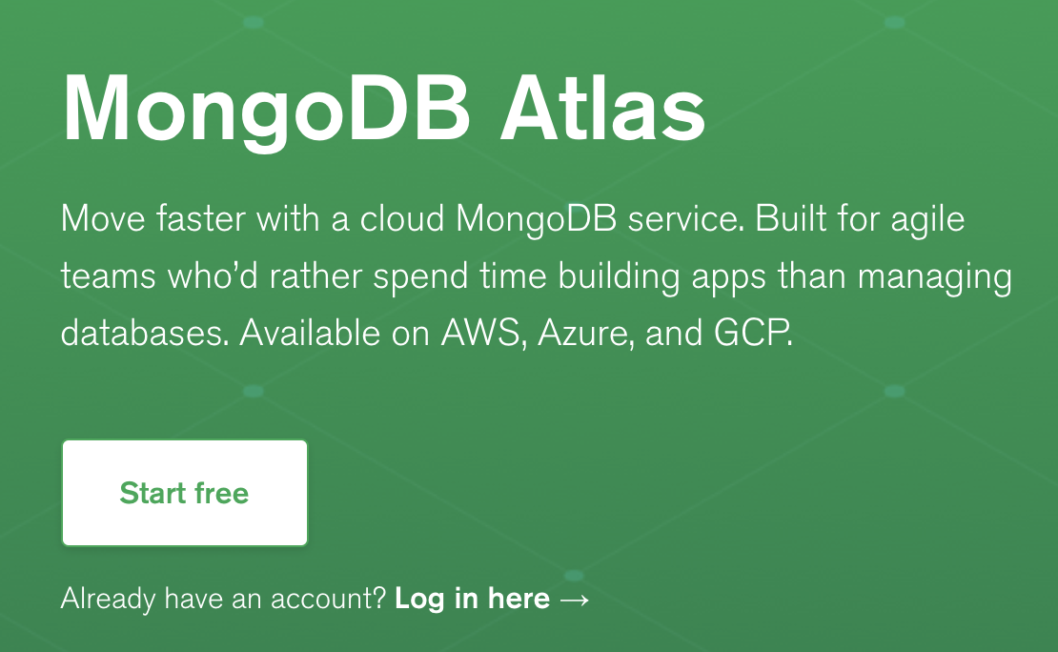
MongoDB Atlas – The Best Way to Run MongoDB

Slide 33
http://bit.ly/MDB_Atlas_Lab1

Slide 34
http://bit.ly/MDB_Stitch_Lab2

Slide 35
http://bit.ly/MDB_Charts_Lab3

Slide 36
https://github.com/khuaulme/Spectra

